Slide 1


Pens
& Printers
Sales Method Analysis and Recommendations
August 2024

Slide 2
Introduction
WE WILL COVER THE FOLLOWING:
DATA VALIDATION AND CLEANING
CUSTOMER COUNT
REVENUE DISTRIBUTION
SALES PERFORMANCE METRICS
SALES ANALYSIS
RECOMMENDATIONS

Slide 3
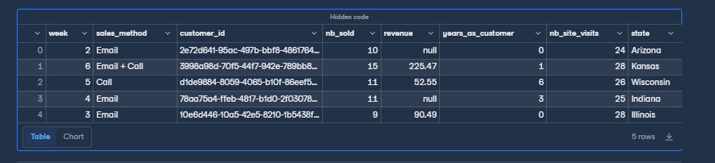
Data Validation and Cleaning
Although there were no duplicates, the raw data initially contained several inconsistencies that I addressed. These included:
The revenue column had 1,074 missing entries, which I filled by calculating the mean.
The week column was in an integer format, so I converted it to a date-time format.
The sales_method column had inconsistent values such as ['Email', 'Email + Call', 'Call', 'em + call', 'email'], which I standardized to ['email', 'email & call', 'call'].

Slide 4
Sales
Analysis.
Back to Agenda Page

Slide 5
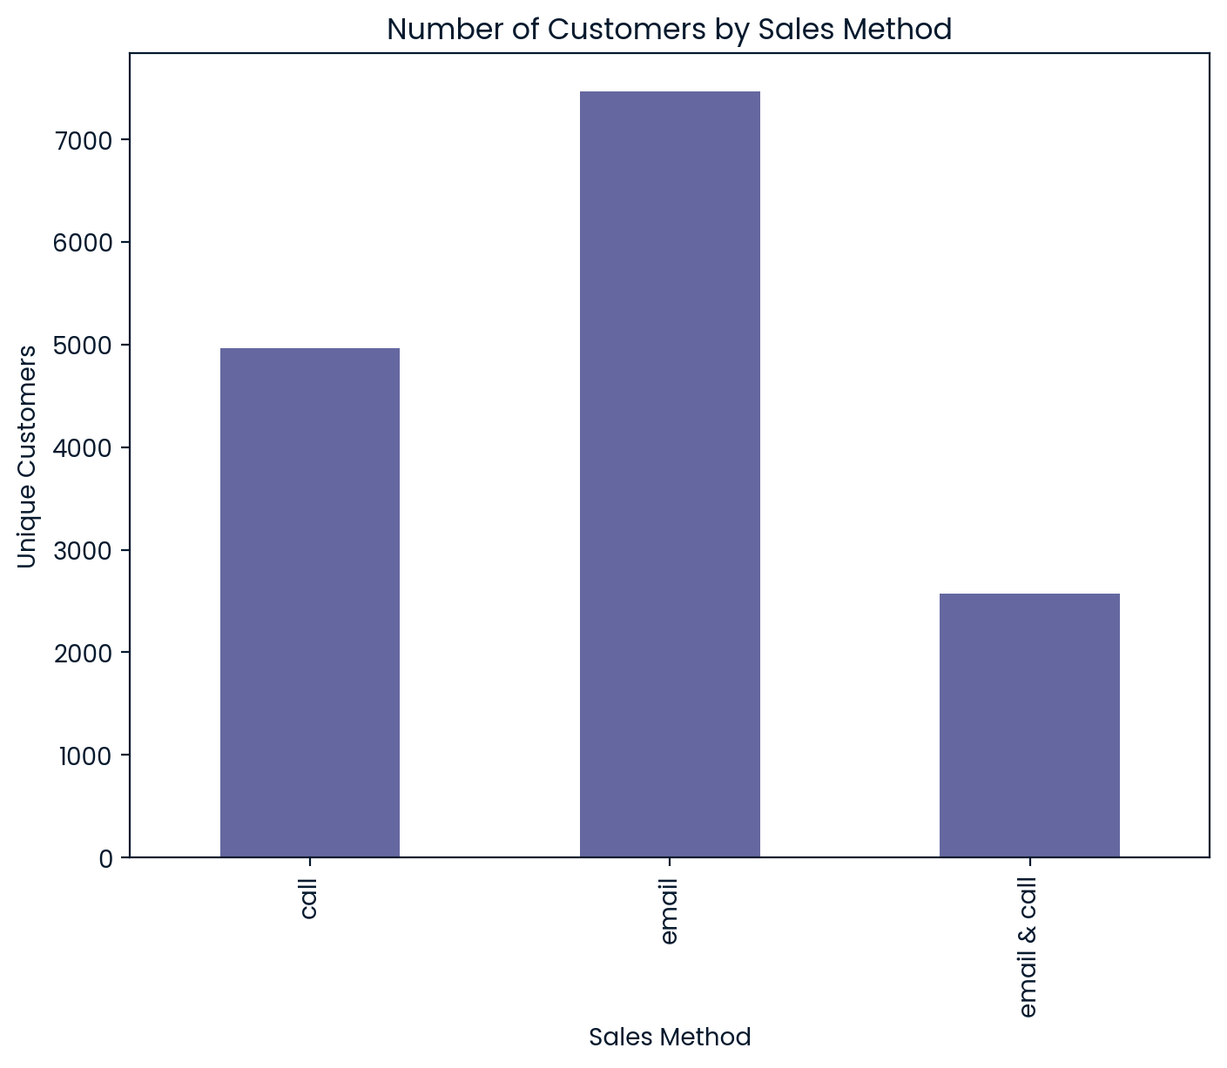
Customer Count
How many customers were there for each approach?
The email-only method proved to be the most effective in attracting customers with minimal effort. To maximize efficiency, it is recommended to continue utilizing this method as the primary outreach strategy.
Back to Agenda Page

Slide 6
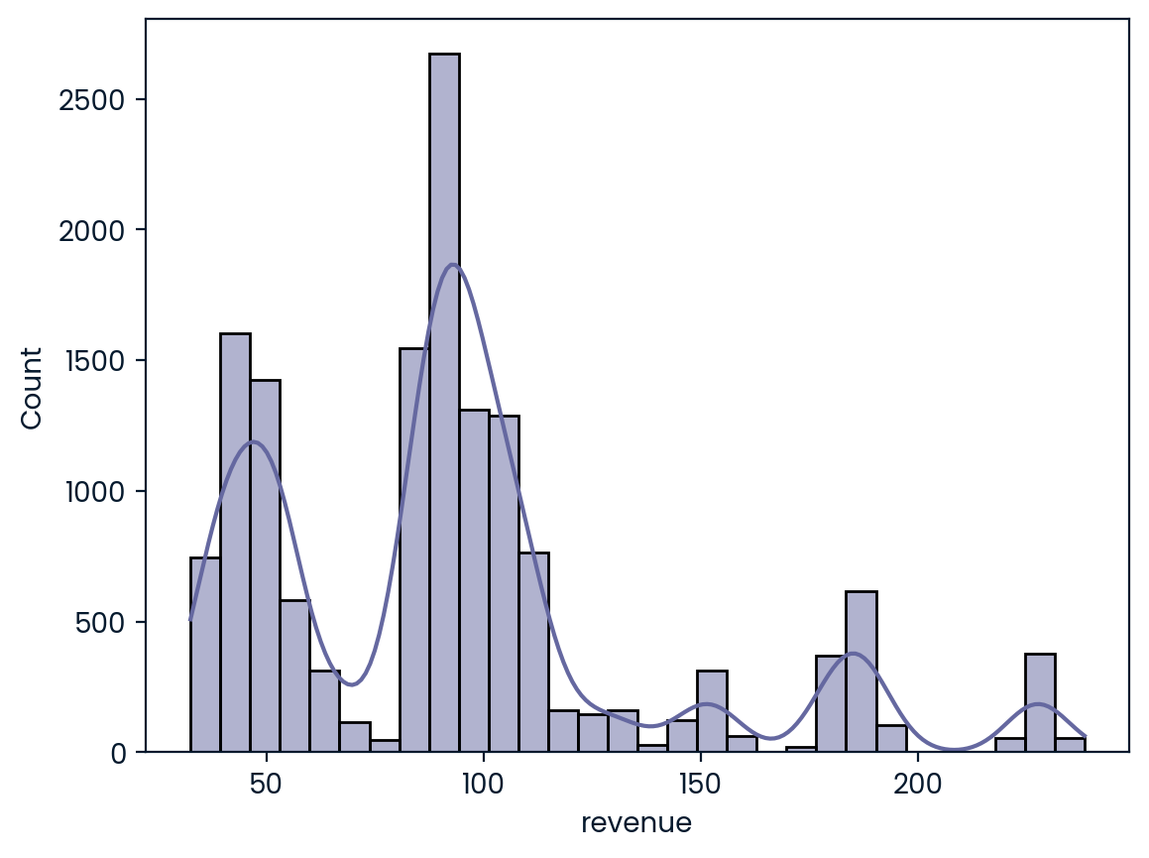
Total Sales Revenue (Distribution).
Breakdown of revenue by count
What does the spread of the revenue look like overall? And for each method?
The chart shows a bimodal revenue distribution with peaks at 40-50 and 90-100, along with gaps and a few outliers.
Back to Agenda Page

Slide 7
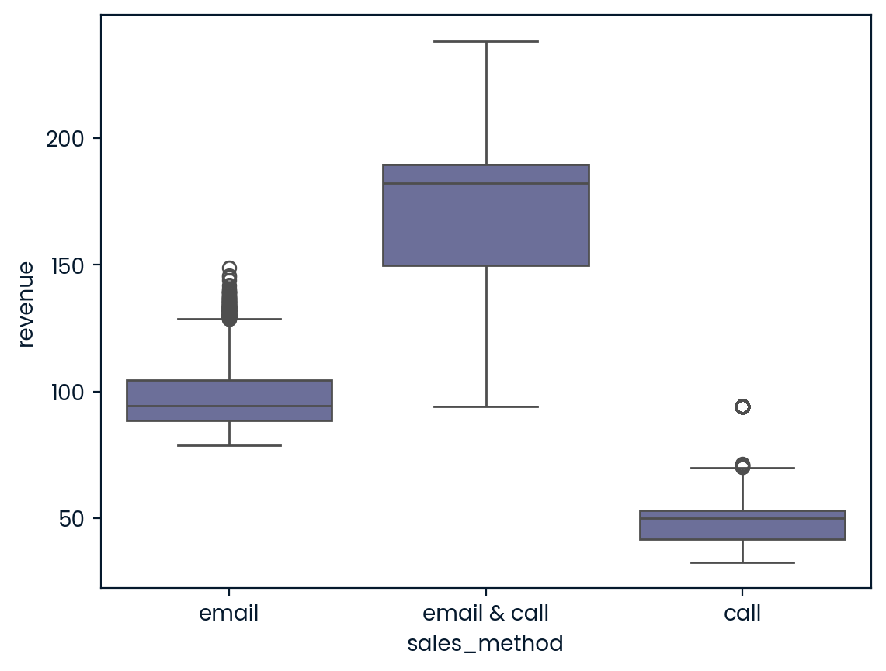
Total Sales Revenue By Method
The "email & call" method generated the highest median revenue. Therefore, it is recommended to prioritize this approach for high-value leads, as it balances higher returns with a moderate level of effort.
Back to Agenda Page

Slide 8
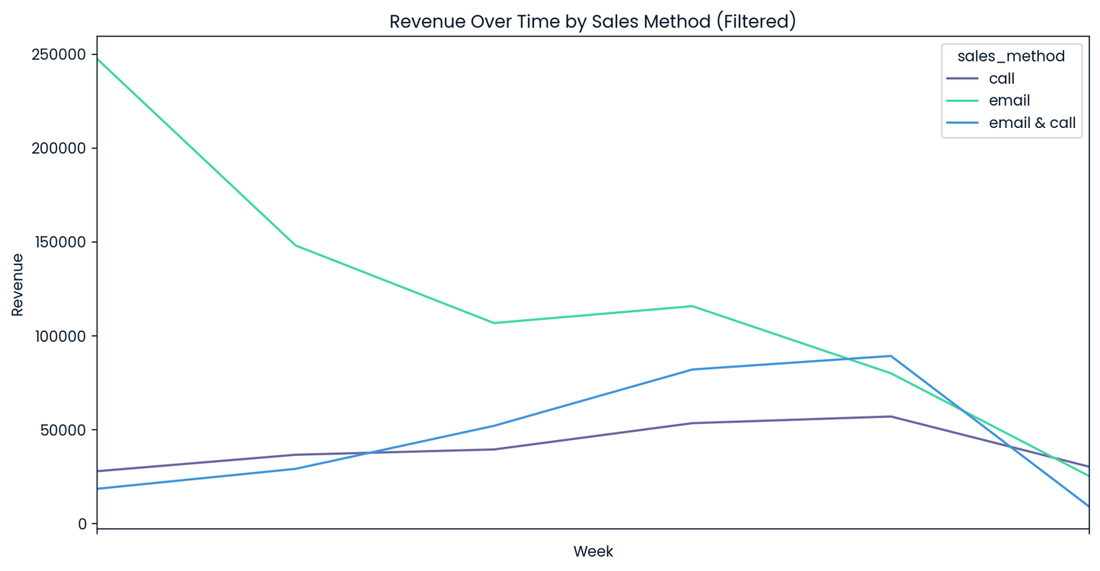
Sales Analysis
Was there any difference in revenue over time for each of the methods?
The "call" method showed high initial revenue but lacked sustainability, while "email & call" offered consistent growth. Use "call" for short-term gains and "email & call" for long-term revenue.
Back to Agenda Page

Slide 9
Recommendations.
Based on the data, which method would you recommend we continue to use?
Email-only: Best for broad customer reach with minimal effort. Continue using this method for general outreach and maintaining customer engagement with low-resource investment.
Email & Call: Best for driving higher revenue with moderate effort. Use this for high-value leads where the combination of email and a brief call can maximize returns without overwhelming the sales team.
Call-only: Best for high-priority, short-term campaigns where a more direct approach is necessary, but not ideal for long-term, resource-efficient strategies.
Back to Agenda Page

Slide 10


Sales Performance Metrics.
Average Revenue per Sales Method
Sales Method | Average Revenue
call | 49.29
email | 96.89
email & call | 171.48
To enhance our sales strategy, track Average Revenue per Sales Method. This will pinpoint which approach yields the highest average revenue, guiding us towards the most effective tactics.

Slide 11
Monitoring Plan
I suggest that we monitor this metric on a weekly or monthly basis. Regular tracking will enable us to:
Identify trends and adjust our strategies to focus on the most successful methods.
If the "Email & Call" method continues to deliver significantly higher revenue, we may want to invest more in this approach, even though it requires more effort.
On the other hand, if the simpler "Email" method shows consistently strong performance, it could present a more efficient option for reaching customers.
By monitoring these averages over time, we can ensure that our resources are being used effectively to maximize revenue and sustain growth.

Slide 12

Thank you!
For questions or suggestions, email hello@reallygreatsite.com

